Slide 1
Python
Numpy , scipy, File I/O
Linear Algebra, Fourier, Polynomials
( Duration 3 Hours )

Slide 2
NumPy
NumPy is the fundamental package for scientific computing with Python. It contains among other things:
a powerful N-dimensional array object
sophisticated (broadcasting) functions
tools for integrating C/C++ and Fortran code
useful linear algebra, Fourier transform, and random number capabilities

Slide 3
NumPy’s main object is the
homogeneous multidimensional array.
It is a table of elements (usually numbers), all of the same type, indexed by a tuple of positive integers. I
n NumPy dimensions are called axes.

Slide 4
For example, the coordinates of a point in 3D space [1, 2, 1] has one axis. That axis has 3 elements in it, so we say it has a length of 3. In the example pictured below, the array has 2 axes. The first axis has a length of 2, the second axis has a length of 3.
[
[ 1., 0., 0.],
[ 0., 1., 2.]
]

Slide 5
ndarray
NumPy’s array class is called ndarray. It is also known by the alias array.
Note that numpy.array is not the same as the Standard Python Library class array.array, which only handles one-dimensional arrays and offers less functionality.

Slide 6
ndarray.ndim
ndarray.shape
ndarray.dtype
ndarray.itemsize
ndarray.data

Slide 7
import numpy as np
a = np.arange(15).reshape(3, 5)
print(a)

Slide 8
The function zeros creates an array full of zeros,
the function ones creates an array full of ones, and
the function empty creates an array whose initial content is random and depends on the state of the memory. By default, the dtype of the created array is float64.

Slide 9
create sequences of numbers
# To create sequences of numbers, NumPy provides a function analogous to range that returns arrays instead of lists.
# sequence
g = np.arange( 10, 30, 5 )
print(g)

Slide 10
import numpy as np
a = np.array( [20,30,40,50] )
b = np.array( [30,40,30,10] )
c = a-b
print(c)

Slide 11
Data processing
+
-
*
Dot = Actual Matrix Multiplecation
/ = Elementwise division

Slide 12
Random
Sum
Min
Max
Cumsum
Axis =0, axis=1
Sqrt

Slide 13
Transpose

Slide 14
Index Access
import numpy as np
a = np.array( [20,30,40,50] )
b = np.array( [30,40,30,10] )
print(a)
print(a[2])
print(a[1:3])
print(a[:3])
#cube root
for i in a:
print(i**(1/3.))
a = np.arange(15).reshape(3, 5)
print(a)
print(a[0:3,2])
print(a[0:,2])

Slide 15
## shape
## shape
a = np.floor(10*np.random.random((3,4)))
print(a)
print(a.ravel()) # returns the array, flattened
print(a.reshape(6,2)) # returns the array with a modified shape
print(a.T) # Transpose

Slide 16
Resize
Reshape
The reshape function returns its argument with a modified shape, whereas the ndarray.resize method modifies the array itself:

Slide 17
stack
Vstack
Hstack
a = np.floor(10*np.random.random((2,2)))
b = np.floor(10*np.random.random((2,2)))
print( np.vstack((a,b)))
print(np.hstack((a,b)))

Slide 18
Basic Statisticscov, mean, std, var
Basic Linear Algebra cross, dot, outer, linalg.svd, vdot

Slide 19
Broadcasting rules
Broadcasting allows universal functions to deal in a meaningful way with inputs that do not have exactly the same shape.
The first rule of broadcasting is that if all input arrays do not have the same number of dimensions, a “1” will be repeatedly prepended to the shapes of the smaller arrays until all the arrays have the same number of dimensions.
The second rule of broadcasting ensures that arrays with a size of 1 along a particular dimension act as if they had the size of the array with the largest shape along that dimension. The value of the array element is assumed to be the same along that dimension for the “broadcast” array.

Slide 20
Ix_
a = np.array([2,3,4,5])
b = np.array([8,5,4])
c = np.array([5,4,6,8,3])
ax,bx,cx = np.ix_(a,b,c)
print(ax)
The ix_ function can be used to combine different vectors so as to obtain the result for each n-uplet. For example, if you want to compute all the a+b*c for all the triplets taken from each of the vectors a, b and c:

Slide 21
Linear algebra
Np.linalg.inv(a)
Np.eye(2)
Np.dot(I,j)
Trace
Np.linalg.solve
Np.linalg.eig(j)

Slide 22
T
Inverse of A matrix
Dot Product
Determenant
Identity matrix

Slide 23
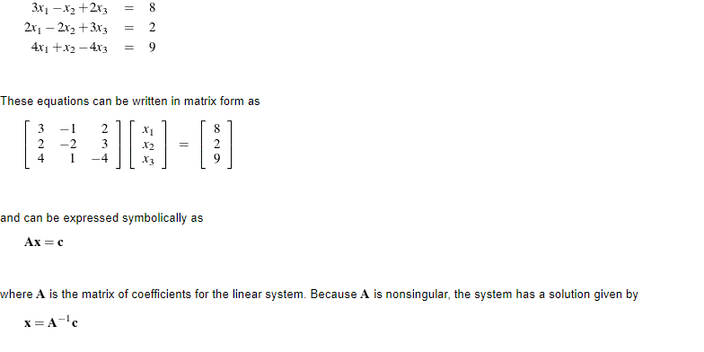
Algebra equation

Slide 24
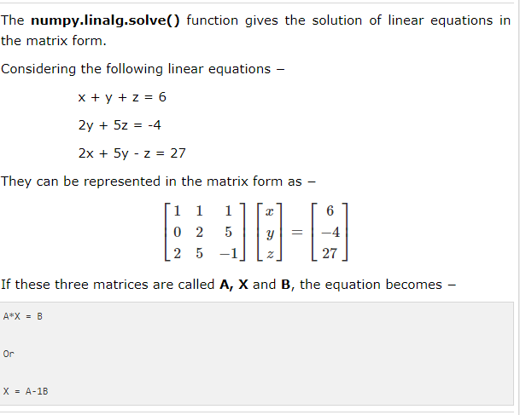

Slide 25
var3="*"
print(var3 * 60 )
#limear algebra equation
A = np.array( [ [3,-1,2], [2,-2,3],[4,1,4] ], dtype=float)
#inverse
Ainv = np.linalg.inv(A)
C = np.array( [[ 8],[2],[9] ])
r = np.dot(Ainv,C)
print(r)
x = np.linalg.solve(A,C)
print(x)

Slide 26
SCIPY
SciPy is a collection of mathematical algorithms and convenience functions built on the Numpy extension of Python.

Slide 27
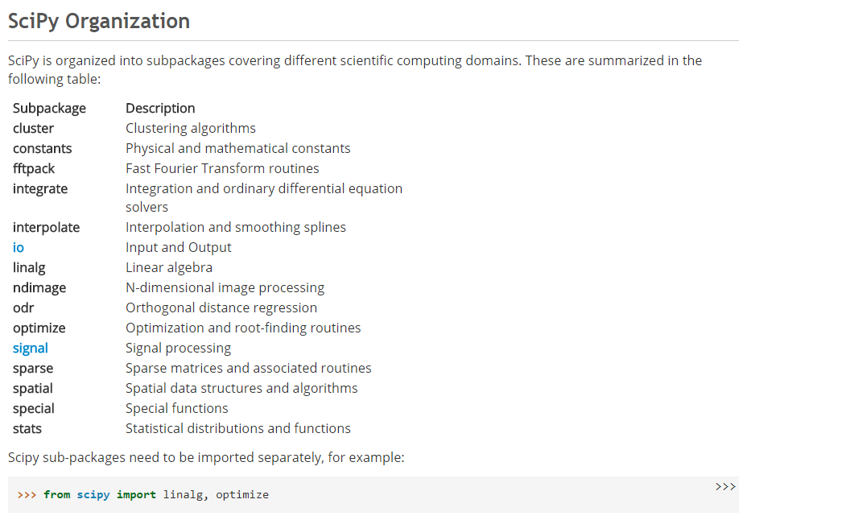

Slide 28
# Polynomials
from scipy import linalg, optimize
from numpy import poly1d
p = poly1d([3,4,5])
print(p*p)

Slide 29
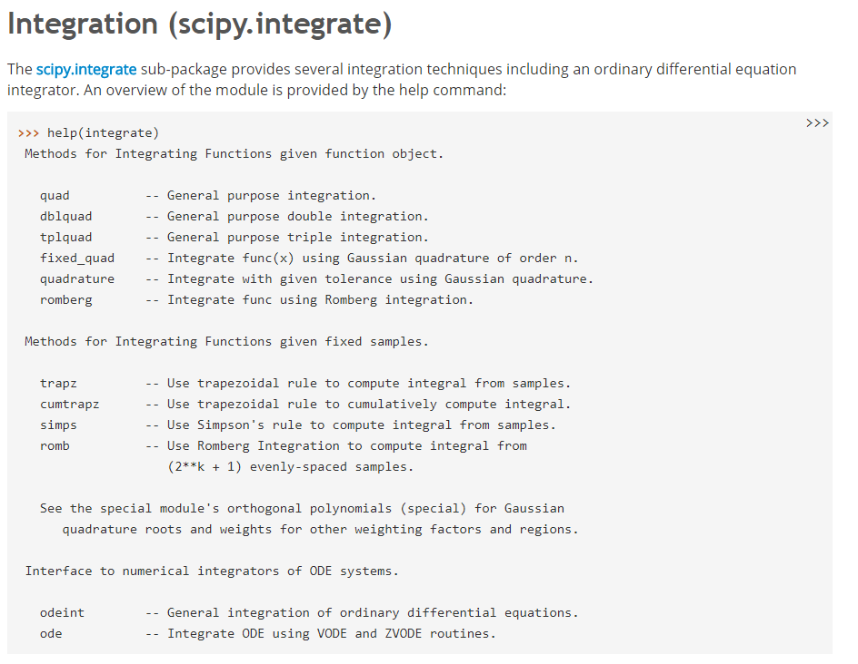

Slide 30
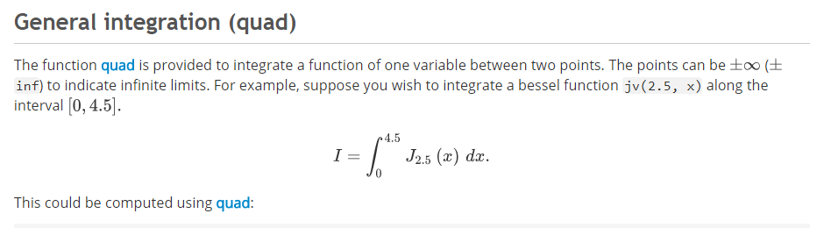

Slide 31
# Integration equation
import scipy.integrate as integrate
import scipy.special as special
result = integrate.quad(lambda x: special.jv(2.5,x), 0, 4.5)
print(result)

Slide 32
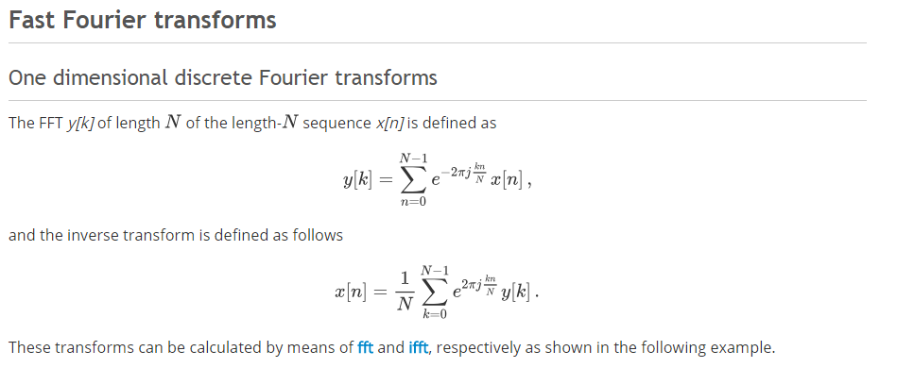
Fourier Transformation

Slide 33
Numpy File i/o
a = np.array([1,2,3,4,5])
np.save('outfile',a)
b = np.load('outfile.npy')
print (b)

Slide 34
np.savetxt('out.txt',a)
b = np.loadtxt('out.txt')
print(b)

